Slide 1

Welcome back!
Studio S9
Ma Chi Kin Brian
e1121386@u.nus.edu
Tele: @bmanara

Slide 2
Just 5 more studios left…

Slide 3
Agenda for Today
Admin Matters
Recap
S9 Studio Worksheet
S9 In-class Studio Worksheet

Slide 4

Admin Matters
Midterms are done and results are out…
Consider scheduling consultations as a group or individual to clear any and all doubts, either with me, Profs or Recitation Tutors.
RA1 + Midterms = 20%, there is still another 80% to gain!

Slide 5
RECAP
Environment Model (IMPORTANT)
Loops & Arrays
CSE Machine
Notes:
*not important/assessed

Slide 6
Environment
An environment determines the context in which our expression is evaluated
Every expression is evaluated with respect to its current environment
It is a sequence of frames.
Each frame contains bindings of values to names
Our frames point to its enclosing environment, the next in the sequence. (Global frame excluded)
Extending an environment means adding a new frame “inside” the old one.

Slide 7
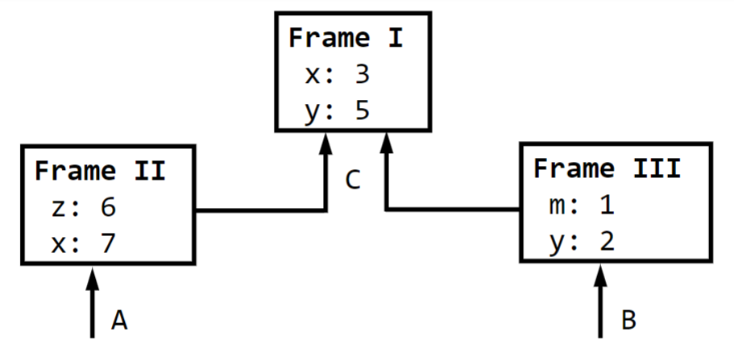
Evaluating a name
To evaluate a name, look it up in the current frame
If not found, look in the enclosing frame… keep going
If it is still not found, the name is unbound in the environment
Value of x in A?
Value of x in B?
Value of m in A?

Slide 8
Evaluating a name
To evaluate a name, look it up in the current frame
If not found, look in the enclosing frame… keep going
If it is still not found, the name is unbound in the environment
Value of x in A = 7
Value of x in B = 3
Value of m in A: unbound

Slide 9
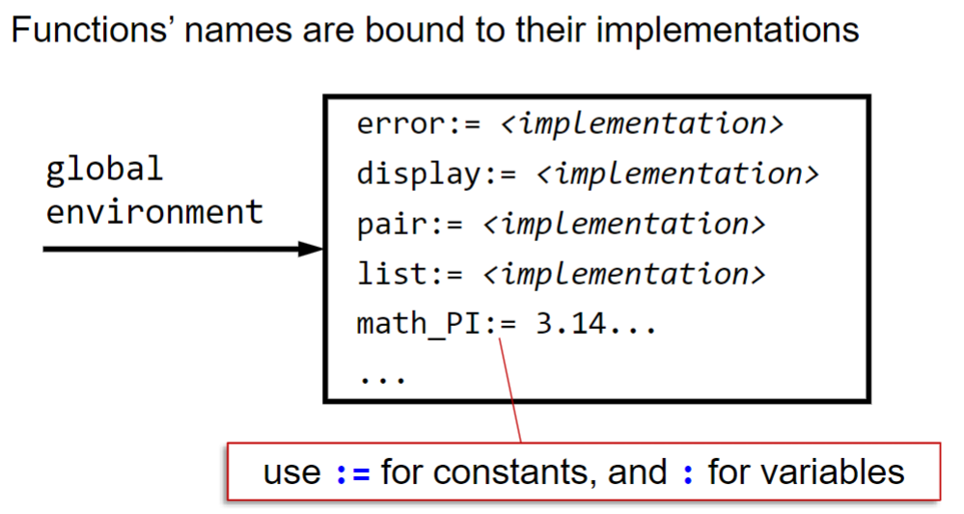
Global Environment
Global Environment consists of a single frame with bindings of primitive and pre-declared functions.

Slide 10
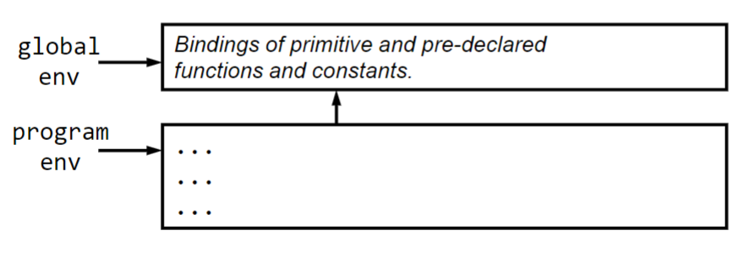
Program Environment
User program directly extends to the global environment
Known as the program environment

Slide 11
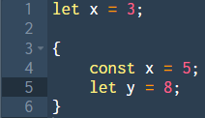
Evaluating Blocks
Consider this program:
How do we draw the environment model?

Slide 12
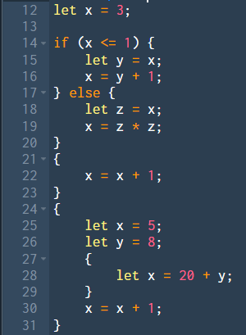
Evaluating Blocks
Consider this program:
How do we draw the environment model?

Slide 13
Evaluation of Function Application
Every function application extends the environment in which the function was created.
New frame contains bindings of parameter variables to the actual arguments passed
If no parameter, no new frame created
Function body block is evaluated in the new environment

Slide 14
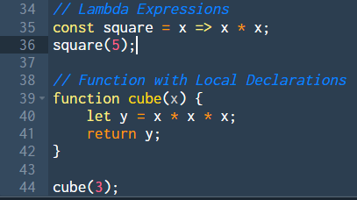
Evaluation of Function Application
Consider this program:

Slide 15
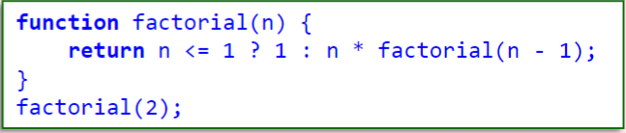
Evaluation of Function Application
Consider this program:

Slide 16
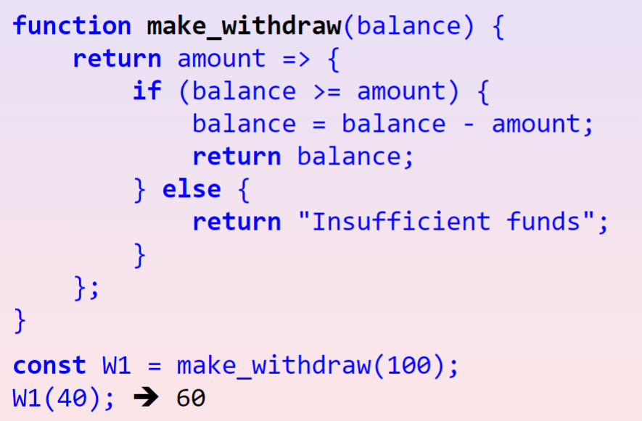
Evaluation of Function Application
Consider this program:

Slide 17
Primitive Values and Compound Structures
Primitive Values
Numbers, strings, Boolean values, null
Drawn inside of frames
a === b works as we might expect
Compound Structures
Pairs, arrays, function objects
Drawn outside of frames
a === b does not work as we expect it to (Sharing and Identity)

Slide 18
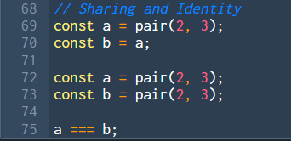
Sharing and Identity
Which returns true?
Which returns false?

Slide 19
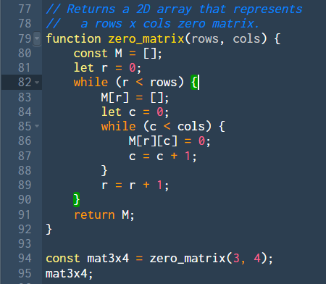
Loops & Arrays
Consider this program:

Slide 20
Rules of Env Model
Draw Program Environment first, extending from global environment
Declaration/Assignments: let “:” and const “:=”
New Block of Code: Create a new frame if necessary (const/variable declarations in block)
Primitive Values (Numbers, Strings, Boolean etc.): Copy them
Compound Structures (Arrays, Pairs etc.): Refer to them (Pointers/References)
Updating Variables: Look for closest assignment (go through frame by frame), then update value
Function Declarations: Draw function object (two balls), right pointer points to the frame it is declared in. Left pointer to params and body.
Function Call: Evaluate arguments first, the evaluate the frame for both the parameters and the body (if needed)
Credit to my Last Year Avenger’s Avenger…
Notes:
It might seem daunting now… But with practice, you will get a lot better!

Slide 21
CSE Machine
We have been focusing solely on the Environment part of the CSE Machine.
What does the Control and Stash do?
Consider the simple expression: 2 * 3 + 4 * 5;

Slide 22

CSE Machine (Expression Statements)
Looking at a sequence of expression statements…
pop instruction is inserted in between our statements on the control to “discard” the intermediate values.
The expression statements are value producing!

Slide 23
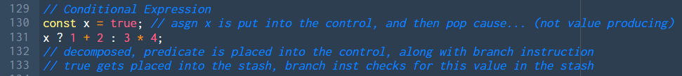
CSE Machine (Conditional Expression)
Conditionals evaluate predicate and then branch.
Let’s see it in Source Playground…
Conditional Statements (if-else) also behave the same. Value producing!

Slide 24
CSE Machine (Logical Compositions)
Logical Compositions: &&, ||
In the control:
x && y → x ? y : false;
x || y → x ? true : y;

Slide 25
CSE Machine (Assignments)
Assignments are value-producing as well!
Consider:
let x = 0;
x = x + 1;

Slide 26
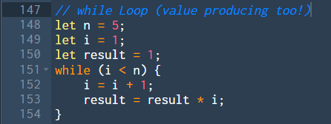
CSE Machine (while Loop)
Consider this program:
while loop pushes undefined, predicate and while inst onto control
while inst: if predicate value is false, DONE!
while inst: if predicate value is true, add pop, body, predicate and same while inst

Slide 27
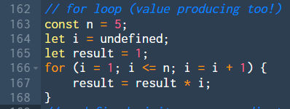
CSE Machine (for Loop)
Consider this program:
for loop pushes undefined, init, pop, predicate and for inst onto control
for inst pops predicate value from stash
If value is false, DONE!
If value is true: add pop, body, increment, pop, predicate, for instr

Slide 28
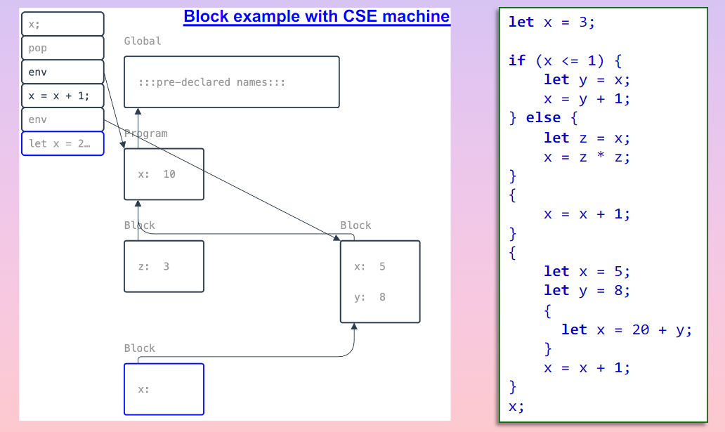
CSE Machine (Blocks)
Special env instruction placed in control to tell program to go back to the correct environment after evaluating some block!

Slide 29
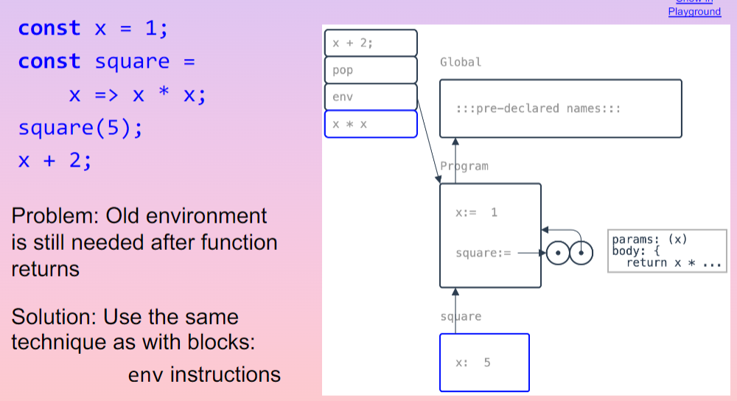
CSE Machine (Functions)
We see the same env instruction here!

Slide 30
CSE Machine Summary
CSE Machine helps to explain the gaps in our environment model
How do we keep track of intermediate values?
In what order do the arguments get evaluated?
What environment do we need to go to after exiting a block and returning from functions?

Slide 31
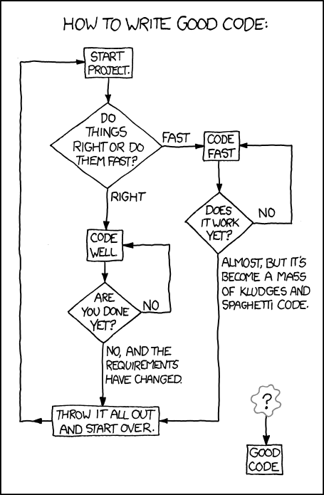
Mutable Data and Environment Model
S9 Studio Sheet

Slide 32
More CSEEEEEEEE?
S9 In-class Studio Sheet

Slide 33
See you next week!
Slides will be uploaded to the google drive.

